Slide 1

Tutorial: Selecting auxiliary variables in R
The Use of R in Official Statistics - uRos2021
26 November 2021
Marcello D’Orazio*
marcello.dorazio(at)istat.it
*Senior Researcher in Statistical Methodology,
Italian National Institute of Statistics – Istat, Rome, Italy

Slide 2
Outline
https://github.com/marcellodo/Tutorial-uRos-2021
1) Introduction: purposes, terms, notations, R
2) «Simple» methods
pairwise association/correlation
3) «Advanced» methods
lasso (linear and logistic regression)
Techniques based on Supervised Statistical Learning
M. D’Orazio | Selecting Auxiliary Variables in R
2

Slide 3
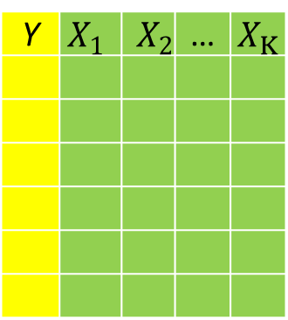
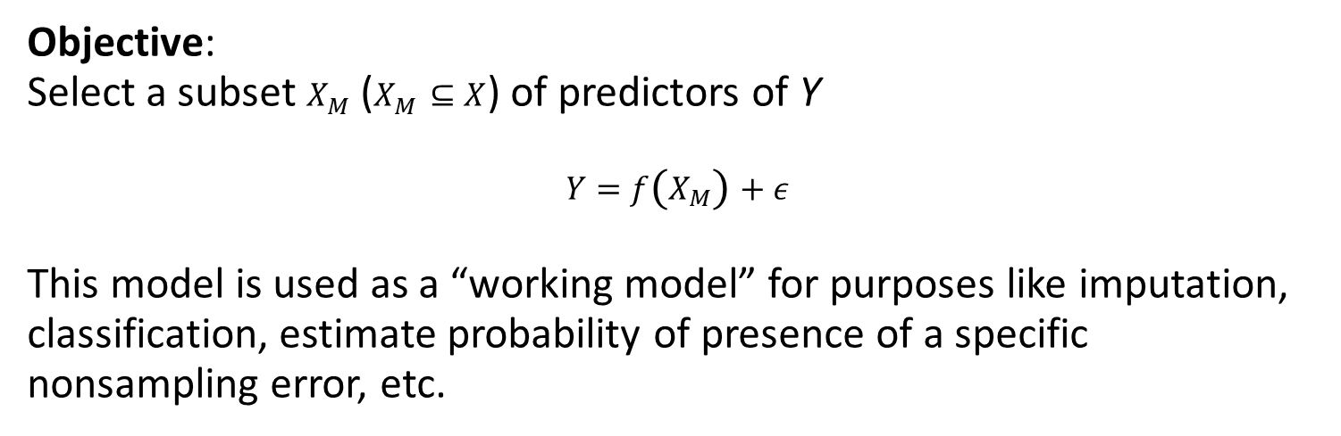
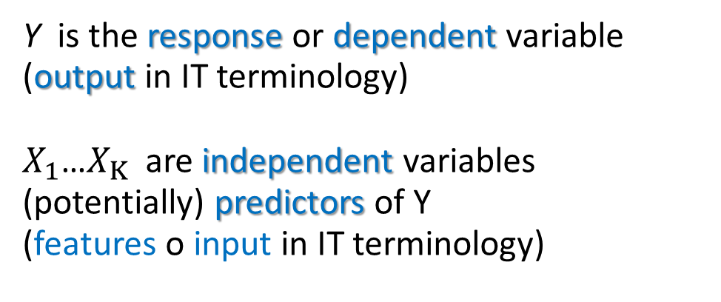
The Problem
Y | $$X_{1}$$ | $$X_{2}$$ | … | $$X_{K}$$
Y is the response or dependent variable (output in IT terminology)
$X_{1}$…$X_{K}$ are independent variables (potentially) predictors of Y
(features o input in IT terminology)
Objective:
Select a subset $X_{M}$ ($X_{M}⊆X$) of predictors of Y
$$Y=f\left(X_{M}\right)+ε$$
This model is used as a “working model” for purposes like imputation, classification, estimate probability of presence of a specific nonsampling error, etc.
M. D’Orazio | Selecting Auxiliary Variables in R
3

Slide 4
The Problem
Examples:
Nearest Neighbor Donor (NND) Imputation of missing values: select variables to be used for calculating the distance
Response errors: identify variables that can indicate the presence of underreporting (hours spent at work in the week)
“Contamination”: presence of hours worked on illegal basis in addition to those worked on under regular contract (“legal”)
M. D’Orazio | Selecting Auxiliary Variables in R
4

Slide 5
Principles and Factors to Consider
Guiding principles:
Identify the “best” of predictors of Y
Avoid redundant predictors
Parsimony: few and relevant predictors
Factors to consider:
Final objective
Approach (parametric, non-parametric, mixed)
Type of Y variable (continuous/categorical)
Type of X variables (all continuous, all categorical, mixed-type)
Size of the dataset
Source of the data (if prob. sample: complex vs simple random sampling):
M. D’Orazio | Selecting Auxiliary Variables in R
5

Slide 6
Principles and Factors to Consider
Size & Source of the data (if prob. sample: complex vs simple random sampling):
selection by procedures based on p-values of a statistical test may be unreliable because large samples usually determine the rejection of the Null Hp (regr. Coeff=0) in addition the statistical tests often are not developed to deal with complex sampling designs…
M. D’Orazio | Selecting Auxiliary Variables in R
6

Slide 7
Variables in R
Type of variable | In R
Continuous | integer
 | numeric
Categorical
Nominal (categories are NOT ordedred, e.g. gender) | factor
Ordinal (categories have a natural ordering, e.g. education level) | ordered factor
M. D’Orazio | Selecting Auxiliary Variables in R
7

Slide 8
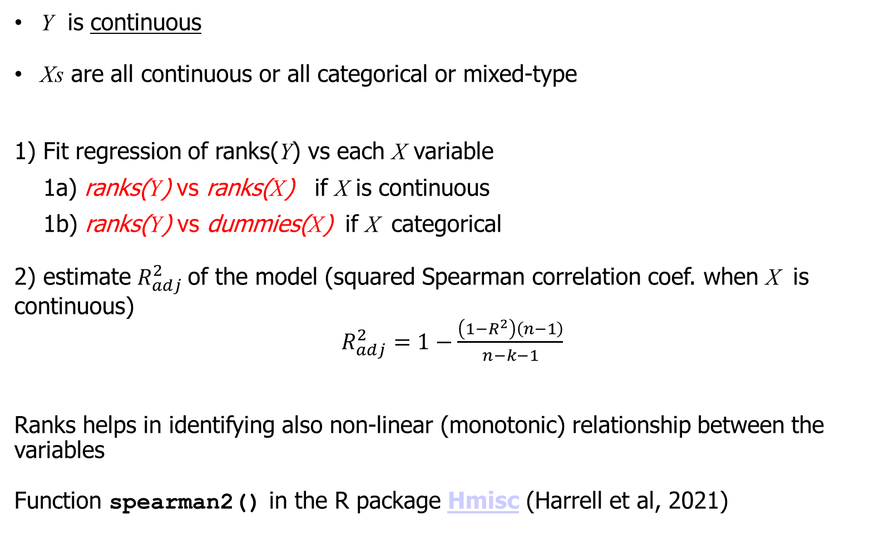
“Simple Methods”: pairwise correlation
Y is continuous
Xs are all continuous or all categorical or mixed-type
1) Fit regression of ranks(Y) vs each X variable
1a) ranks(Y) vs ranks(X) if X is continuous
1b) ranks(Y) vs dummies(X) if X categorical
2) estimate $R_{adj}^{2}$of the model (squared Spearman correlation coef. when X is continuous)
$R_{adj}^{2}=1−\frac{\left(1−R^{2}\right)\left(n−1\right)}{n−k−1}$
Ranks helps in identifying also non-linear (monotonic) relationship between the variables
Function spearman2() in the R package Hmisc (Harrell et al, 2021)
M. D’Orazio | Selecting Auxiliary Variables in R
8

Slide 9
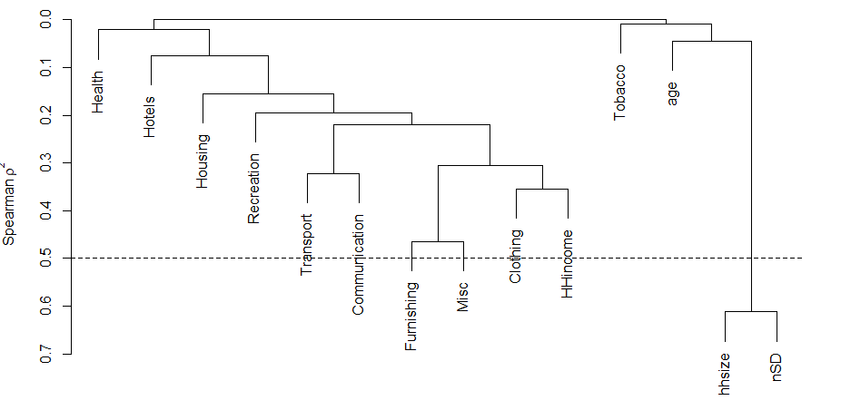
Multicollinearity in Predictors: Redundancy Analysis
Identify redundant predictors (when all the Xs are continuous):
redundancy analysis
variable clustering: hierarchical clustering based on a matrix of similarities between the various X variables (default speraman squared cor. coef.)
vc <- varclus(x = data.matrix(hhExp[,xs]), similarity = "spearman")
plot(vc)
abline(h=0.5, lty=2)
M. D’Orazio | Selecting Auxiliary Variables in R
9

Slide 10
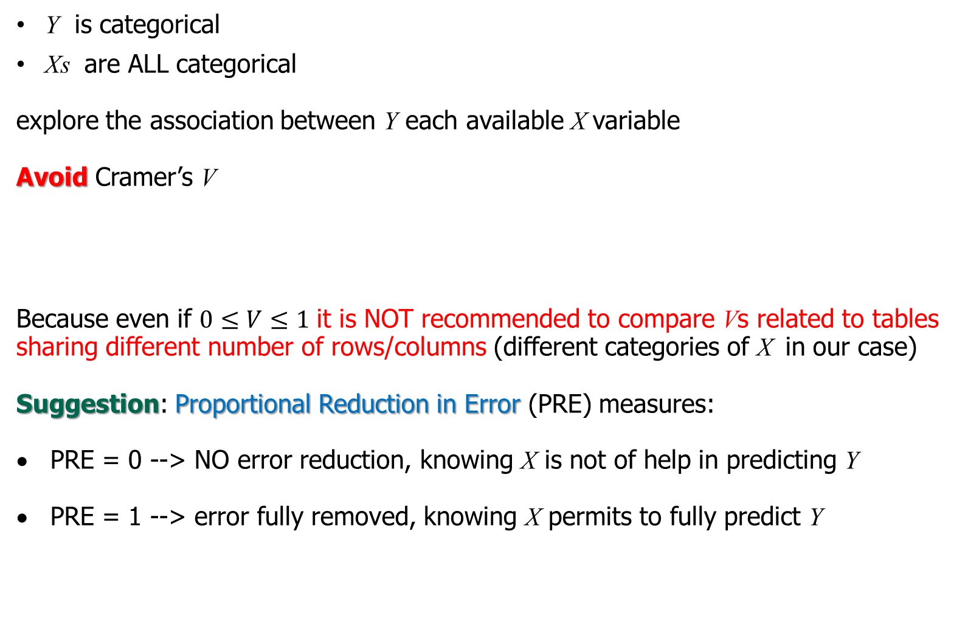
Pairwise Association Measures
Y is categorical
Xs are ALL categorical
explore the association between Y each available X variable
Avoid Cramer’s V
Because even if $0≤V≤1$ it is NOT recommended to compare Vs related to tables sharing different number of rows/columns (different categories of X in our case)
Suggestion: Proportional Reduction in Error (PRE) measures:
PRE = 0 --> NO error reduction, knowing X is not of help in predicting Y
PRE = 1 --> error fully removed, knowing X permits to fully predict Y
M. D’Orazio | Selecting Auxiliary Variables in R
10

Slide 11
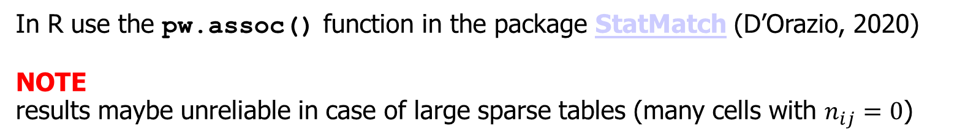
Pairwise Association Measures
Some PRE measures
In R use the pw.assoc() function in the package StatMatch (D’Orazio, 2020)
NOTE
results maybe unreliable in case of large sparse tables (many cells with $n_{ij}=0$)
M. D’Orazio | Selecting Auxiliary Variables in R
11

Slide 12
Pairwise Association Measures
The pw.assoc() estimates also AIC and BIC (having penalty depending on the number of relative frequencies to be estimated):
The package catdap (The Institute of Statistical Mathematics, 2020) uses AIC to select a subset of the available predictors that jointly work better as predictors of Y
M. D’Orazio | Selecting Auxiliary Variables in R
12

Slide 13
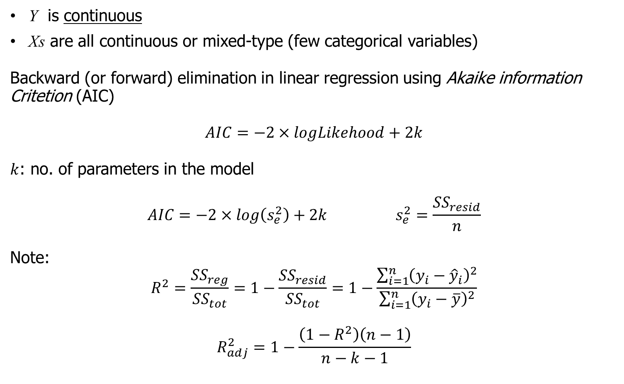
Linear Regression: stepwise based on AIC
Y is continuous
Xs are all continuous or mixed-type (few categorical variables)
Backward (or forward) elimination in linear regression using Akaike information Critetion (AIC)
$$AIC=−2×logLikehood+2k$$
$k$: no. of parameters in the model
$$AIC=−2×log\left(s_{e}^{2}\right)+2k s_{e}^{2}=\frac{{SS}_{resid}}{n}$$
Note:
$$R^{2}=\frac{{SS}_{reg}}{{SS}_{tot}}=1−\frac{{SS}_{resid}}{{SS}_{tot}}=1−\frac{\sum_{i=1}^{n}{{\left(y_{i}−{\hat{y}}_{i}\right)}^{2}}}{\sum_{i=1}^{n}{{\left(y_{i}−\overline{y}\right)}^{2}}}$$
$$R_{adj}^{2}=1−\frac{\left(1−R^{2}\right)\left(n−1\right)}{n−k−1}$$
M. D’Orazio | Selecting Auxiliary Variables in R
13

Slide 14
Linear Regression: stepwise based on AIC
Use stepAIC() function in the R package MASS (Venables & Ripley, 2002)
the package glmulti has facilities for an IC-based selection of the best model. It handles Generalized Linear Models
M. D’Orazio | Selecting Auxiliary Variables in R
14

Slide 15
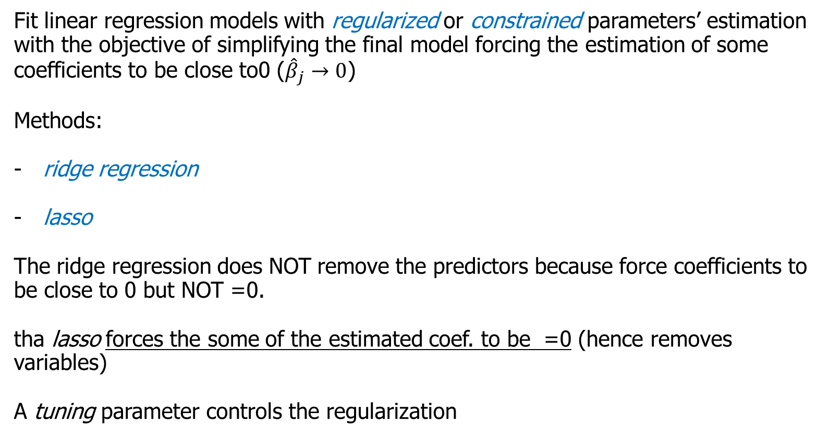
Linear Regression: Shrinkage Methods
Fit linear regression models with regularized or constrained parameters’ estimation with the objective of simplifying the final model forcing the estimation of some coefficients to be close to0 (${\hat{β}}_{j}→0$)
Methods:
ridge regression
lasso
The ridge regression does NOT remove the predictors because force coefficients to be close to 0 but NOT =0.
tha lasso forces the some of the estimated coef. to be =0 (hence removes variables)
A tuning parameter controls the regularization
M. D’Orazio | Selecting Auxiliary Variables in R
15

Slide 16
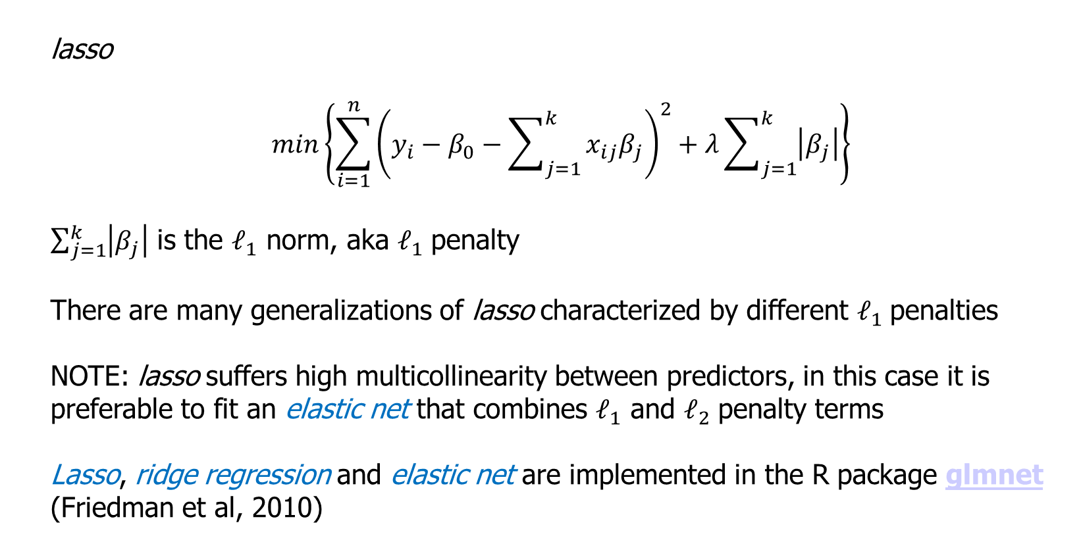
Linear Regression: lasso
lasso
$$min\left\{\sum_{i=1}^{n}{{\left(y_{i}−β_{0}−\sum_{j=1}^{k}{x_{ij}β_{j}}\right)}^{2}}+λ\sum_{j=1}^{k}{\left|β_{j}\right|}\right\}$$
$\sum_{j=1}^{k}{\left|β_{j}\right|}$ is the $𝓁_{1}$ norm, aka $𝓁_{1}$ penalty
There are many generalizations of lasso characterized by different $𝓁_{1}$ penalties
NOTE: lasso suffers high multicollinearity between predictors, in this case it is preferable to fit an elastic net that combines $𝓁_{1}$ and $𝓁_{2}$ penalty terms
Lasso, ridge regression and elastic net are implemented in the R package glmnet (Friedman et al, 2010)
M. D’Orazio | Selecting Auxiliary Variables in R
16

Slide 17
Linear Regression: lasso
Main arguments of the glmnet() function:
- x matrix with candidate predictors
- y vector with values of the response variable
- family: tytpe of model
= "gaussian" -> linear regr. (Gaussian error term)
= "binomial" -> logistic model (y=0 or y=1)
= "poisson" -> Y observes counts (0,1,2,3)
= "multinomial" -> Y categorical multinomial (more than 2 unordered
categories)
- alpha: elastic net mix, in the [0, 1] interval
= 0 -> ridge regression
= 1 -> lasso (default)
- nlambda, number of different values for the lambda argument that handles the penalty (lambda=0 means no penalty) increasing the lambda values increases the no. of coef. forced to be 0
To identify the value of lambda that minimizes the MSE it is suggested to apply cross-validation implemented in the cv.glmnet() function
M. D’Orazio | Selecting Auxiliary Variables in R
17

Slide 18
Linear Regression: relaxed lasso
glmnet v3.0 introduced relaxed lasso consisting of 2 steps:
Fits a glmnet
for each lambda value a model without penalty is fitted
Very efficient and effective in reducing the predictors
glmnet can handle mixed type predictors, but it is needed a data treatment step using the function makeX(): basically replaces a categorical variable with the corresponding dummies
M. D’Orazio | Selecting Auxiliary Variables in R
18

Slide 19
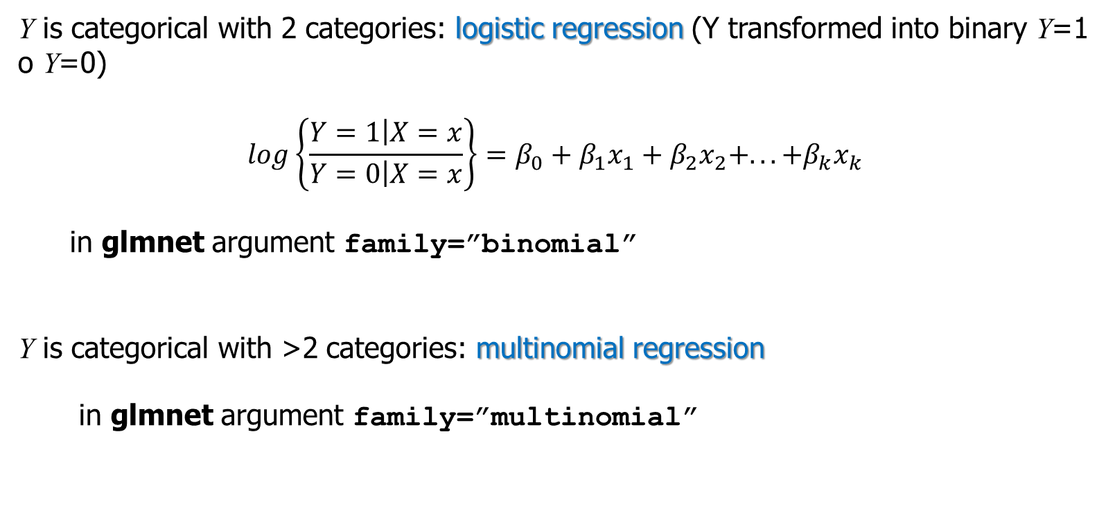
glmnet: “binomial” and “multinomial” families
Y is categorical with 2 categories: logistic regression (Y transformed into binary Y=1 o Y=0)
$$log\left\{\frac{Y=1\left|X=x\right.}{Y=0\left|X=x\right.}\right\}=β_{0}+β_{1}x_{1}+β_{2}x_{2}+...+β_{k}x_{k}$$
in glmnet argument family=”binomial”
Y is categorical with >2 categories: multinomial regression
in glmnet argument family=”multinomial”
M. D’Orazio | Selecting Auxiliary Variables in R
19

Slide 20
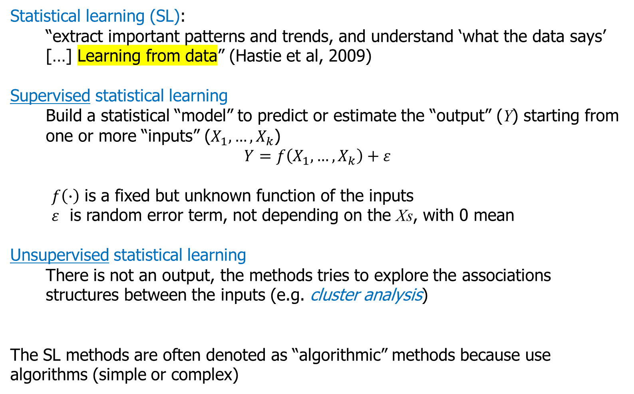
Statistical Learning Methods
Statistical learning (SL):
“extract important patterns and trends, and understand ‘what the data says’ […] Learning from data” (Hastie et al, 2009)
Supervised statistical learning
Build a statistical “model” to predict or estimate the “output” (Y) starting from one or more “inputs” ($X_{1},…,X_{k}$)
$$Y=f\left(X_{1},…,X_{k}\right)+ε$$
$f\left(∙\right)$ is a fixed but unknown function of the inputs
$ε$ is random error term, not depending on the Xs, with 0 mean
Unsupervised statistical learning
There is not an output, the methods tries to explore the associations structures between the inputs (e.g. cluster analysis)
The SL methods are often denoted as “algorithmic” methods because use algorithms (simple or complex)
M. D’Orazio | Selecting Auxiliary Variables in R
20

Slide 21
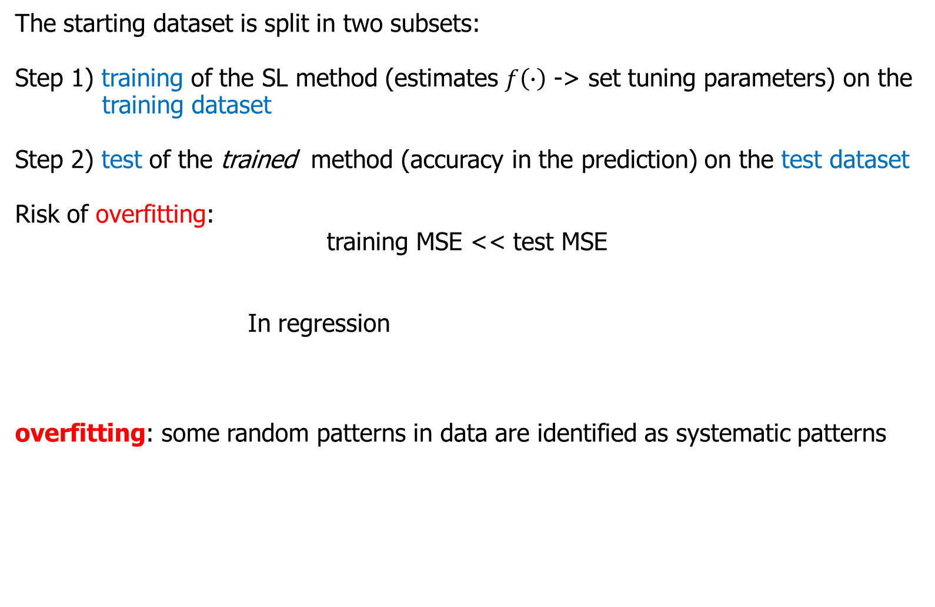
Statistical Learning Methods
The starting dataset is split in two subsets:
Step 1) training of the SL method (estimates $f\left(∙\right)$ -> set tuning parameters) on the training dataset
Step 2) test of the trained method (accuracy in the prediction) on the test dataset
Risk of overfitting:
training MSE << test MSE
In regression
overfitting: some random patterns in data are identified as systematic patterns
M. D’Orazio | Selecting Auxiliary Variables in R
21

Slide 22
Statistical Learning Methods
The SL methods:
Can identify complex relationship between Y and some of the Xs
Often can handle mixed-type predictors (continuous and categorical)
Often provide a score that indicates the “importance” of predictors in predicting Y
The importance scores are often used as a tool for selecting the best predictors of Y
Caution in interpreting the scores
M. D’Orazio | Selecting Auxiliary Variables in R
22

Slide 23
Classification And Regression Trees
CART: Classification And Regression Trees
Recursive partitioning of the observations using each time one of the available predictors so to identify subsets of homogeneous Y values
Predictors appearing on the top of the fitted trees are those found as most important in predicting Y
R several packages: most popular tree (Ripley, 2021) o rpart (Therneau and Atkinson, 2019)
Basic trees are known to be affected by a selection bias: in selecting the predictor for splitting observations they favor predictors allowing more potential splits:
Continuous variables preferred to categorical
Categorical with many categories preferred to categorical with few categories
In addition they are not able to account for multicollinearity
M. D’Orazio | Selecting Auxiliary Variables in R
23

Slide 24
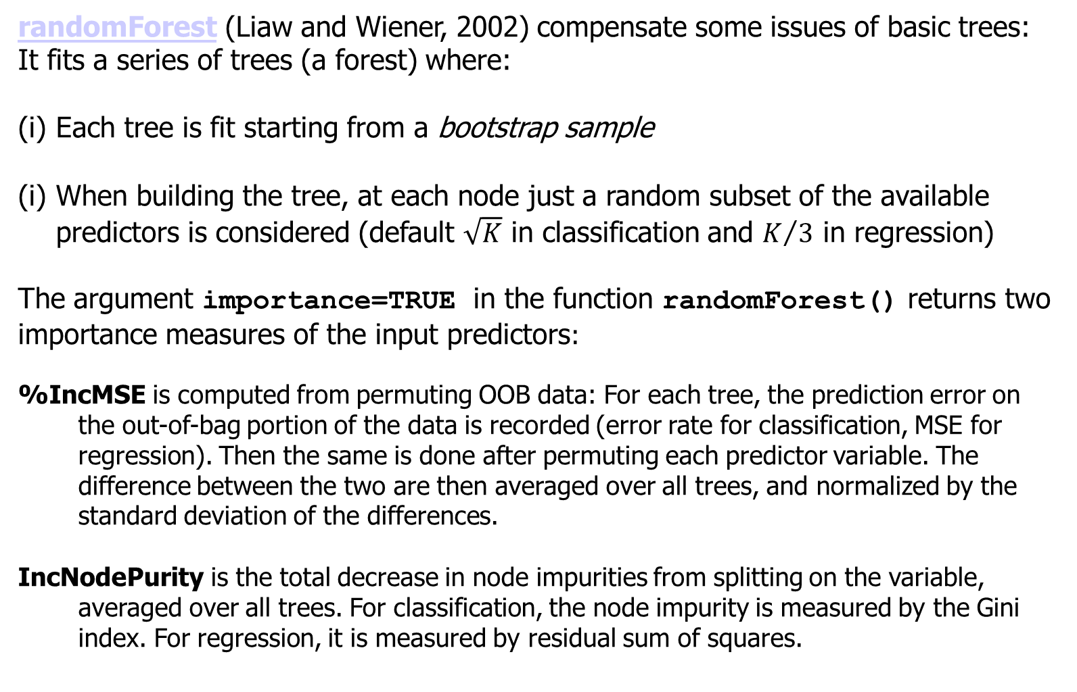
randomForest
randomForest (Liaw and Wiener, 2002) compensate some issues of basic trees:
It fits a series of trees (a forest) where:
Each tree is fit starting from a bootstrap sample
When building the tree, at each node just a random subset of the available predictors is considered (default $\sqrt{K}$ in classification and $K/3$ in regression)
The argument importance=TRUE in the function randomForest() returns two importance measures of the input predictors:
%IncMSE is computed from permuting OOB data: For each tree, the prediction error on the out-of-bag portion of the data is recorded (error rate for classification, MSE for regression). Then the same is done after permuting each predictor variable. The difference between the two are then averaged over all trees, and normalized by the standard deviation of the differences.
IncNodePurity is the total decrease in node impurities from splitting on the variable, averaged over all trees. For classification, the node impurity is measured by the Gini index. For regression, it is measured by residual sum of squares.
M. D’Orazio | Selecting Auxiliary Variables in R
24

Slide 25
Conditional Inference Trees
The issue of selection bias is better approached with the conditional inference trees (Strobl et al, 2008)
See the function cforest() in the package party (Hothorn et al, 2006).
The function varimp() in party returns the importance of predictors in terms of mean decrease in accuracy
When launched with the argument conditional=TRUE the importance score is calculated by permuting the predictors most linked to Y.
This device compensates multicollinearity between predictors.
M. D’Orazio | Selecting Auxiliary Variables in R
25

Slide 26
Variable Importance Facilities
Many SL methods allow estimating the importance of predictors
In R a large series of SL methods can be launched by means od the package caret (Classification And REgression Training; Kuhn, 2021).
A series of additional packages can help in analyzing and interpreting the results of the fitting of SL methods.
The package varImp (Probst, 2020) is tailored to analyzing variable importance measures
M. D’Orazio | Selecting Auxiliary Variables in R
26

Slide 27
Shrinkage Methods
eXtreme Gradient Boosting (XGBoost, Chen and Guestrin, 2016) is a SL method vary efficient and effective in prediction problems is.
It is an implementation of a gradient boosting (GB) procedure:
Boosting: combines a series of weak procedures (e.g. CART) but at each iteration the unit’s weight are modified; for instance, in classification problems (Y is categorical) the misclassified observations receive an higher weigh in the subsequent iteration
Gradient: introduces a loss function to avoid overfitting, by penalizing too complex models
XGBoost is implemented in the R package xgboost (Chen et al, 2021)
M. D’Orazio | Selecting Auxiliary Variables in R
27

Slide 28
Thank you for your attention

